Slide 2
Upton Bishop
Traffic Calming & Speed Reduction Proposals

Slide 3
Why these proposals now ?
Upton Bishop has been allocated £125k for traffic calming measures.
Monies need to be allocated within this current financial year
Proposals need to be achievable
Prioritised list to be submitted early February 2023
What has been done ?
Parish Council reviewed previous reports
Previous input from community
Walked routes completing inspection of existing measures
Site visits to other local villages with traffic calming measures
Prepare prioritised list for Herefordshire Council

Slide 4
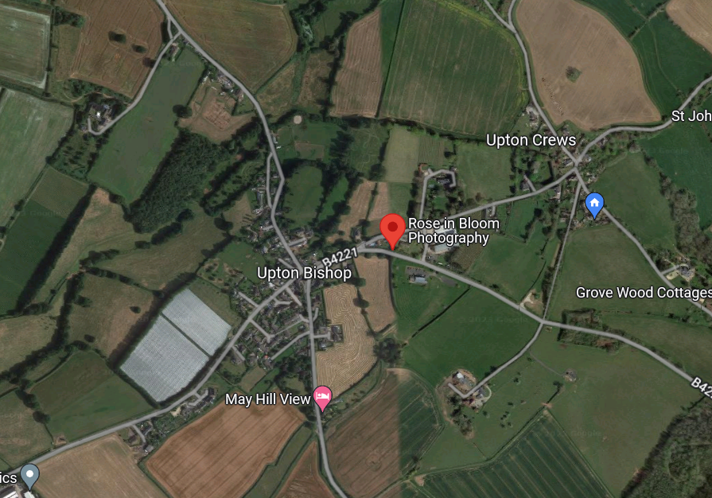

Slide 8
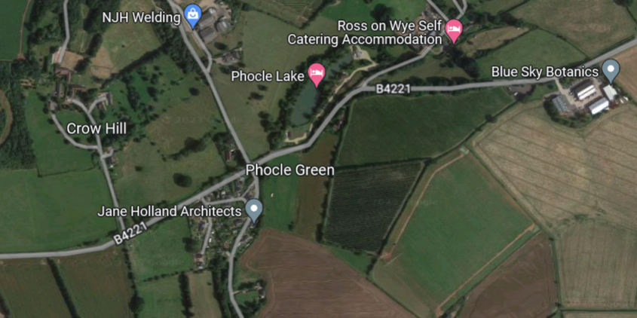

Slide 9
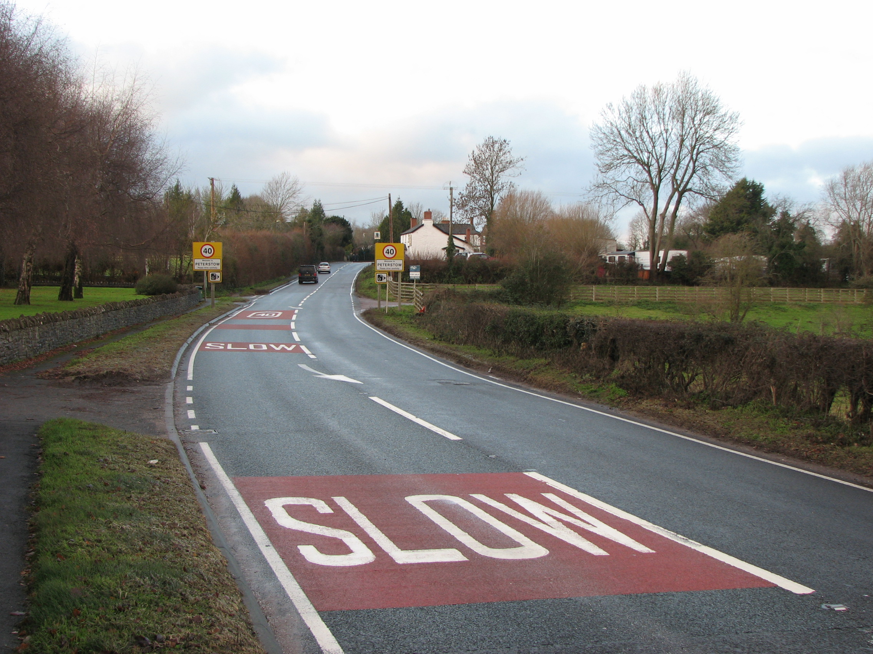
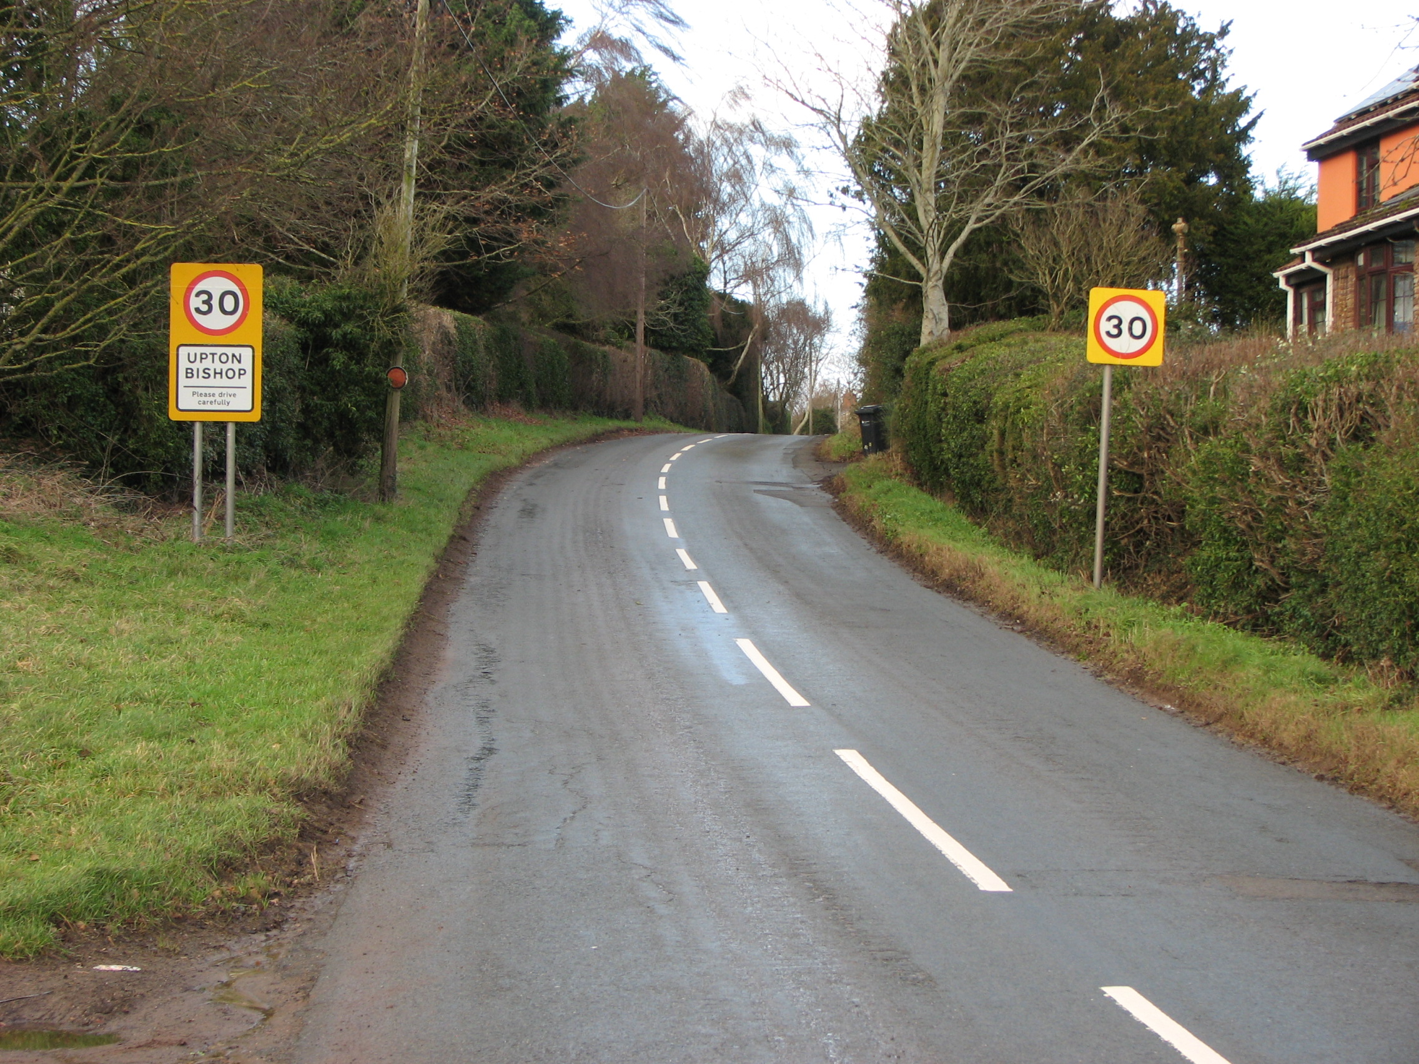
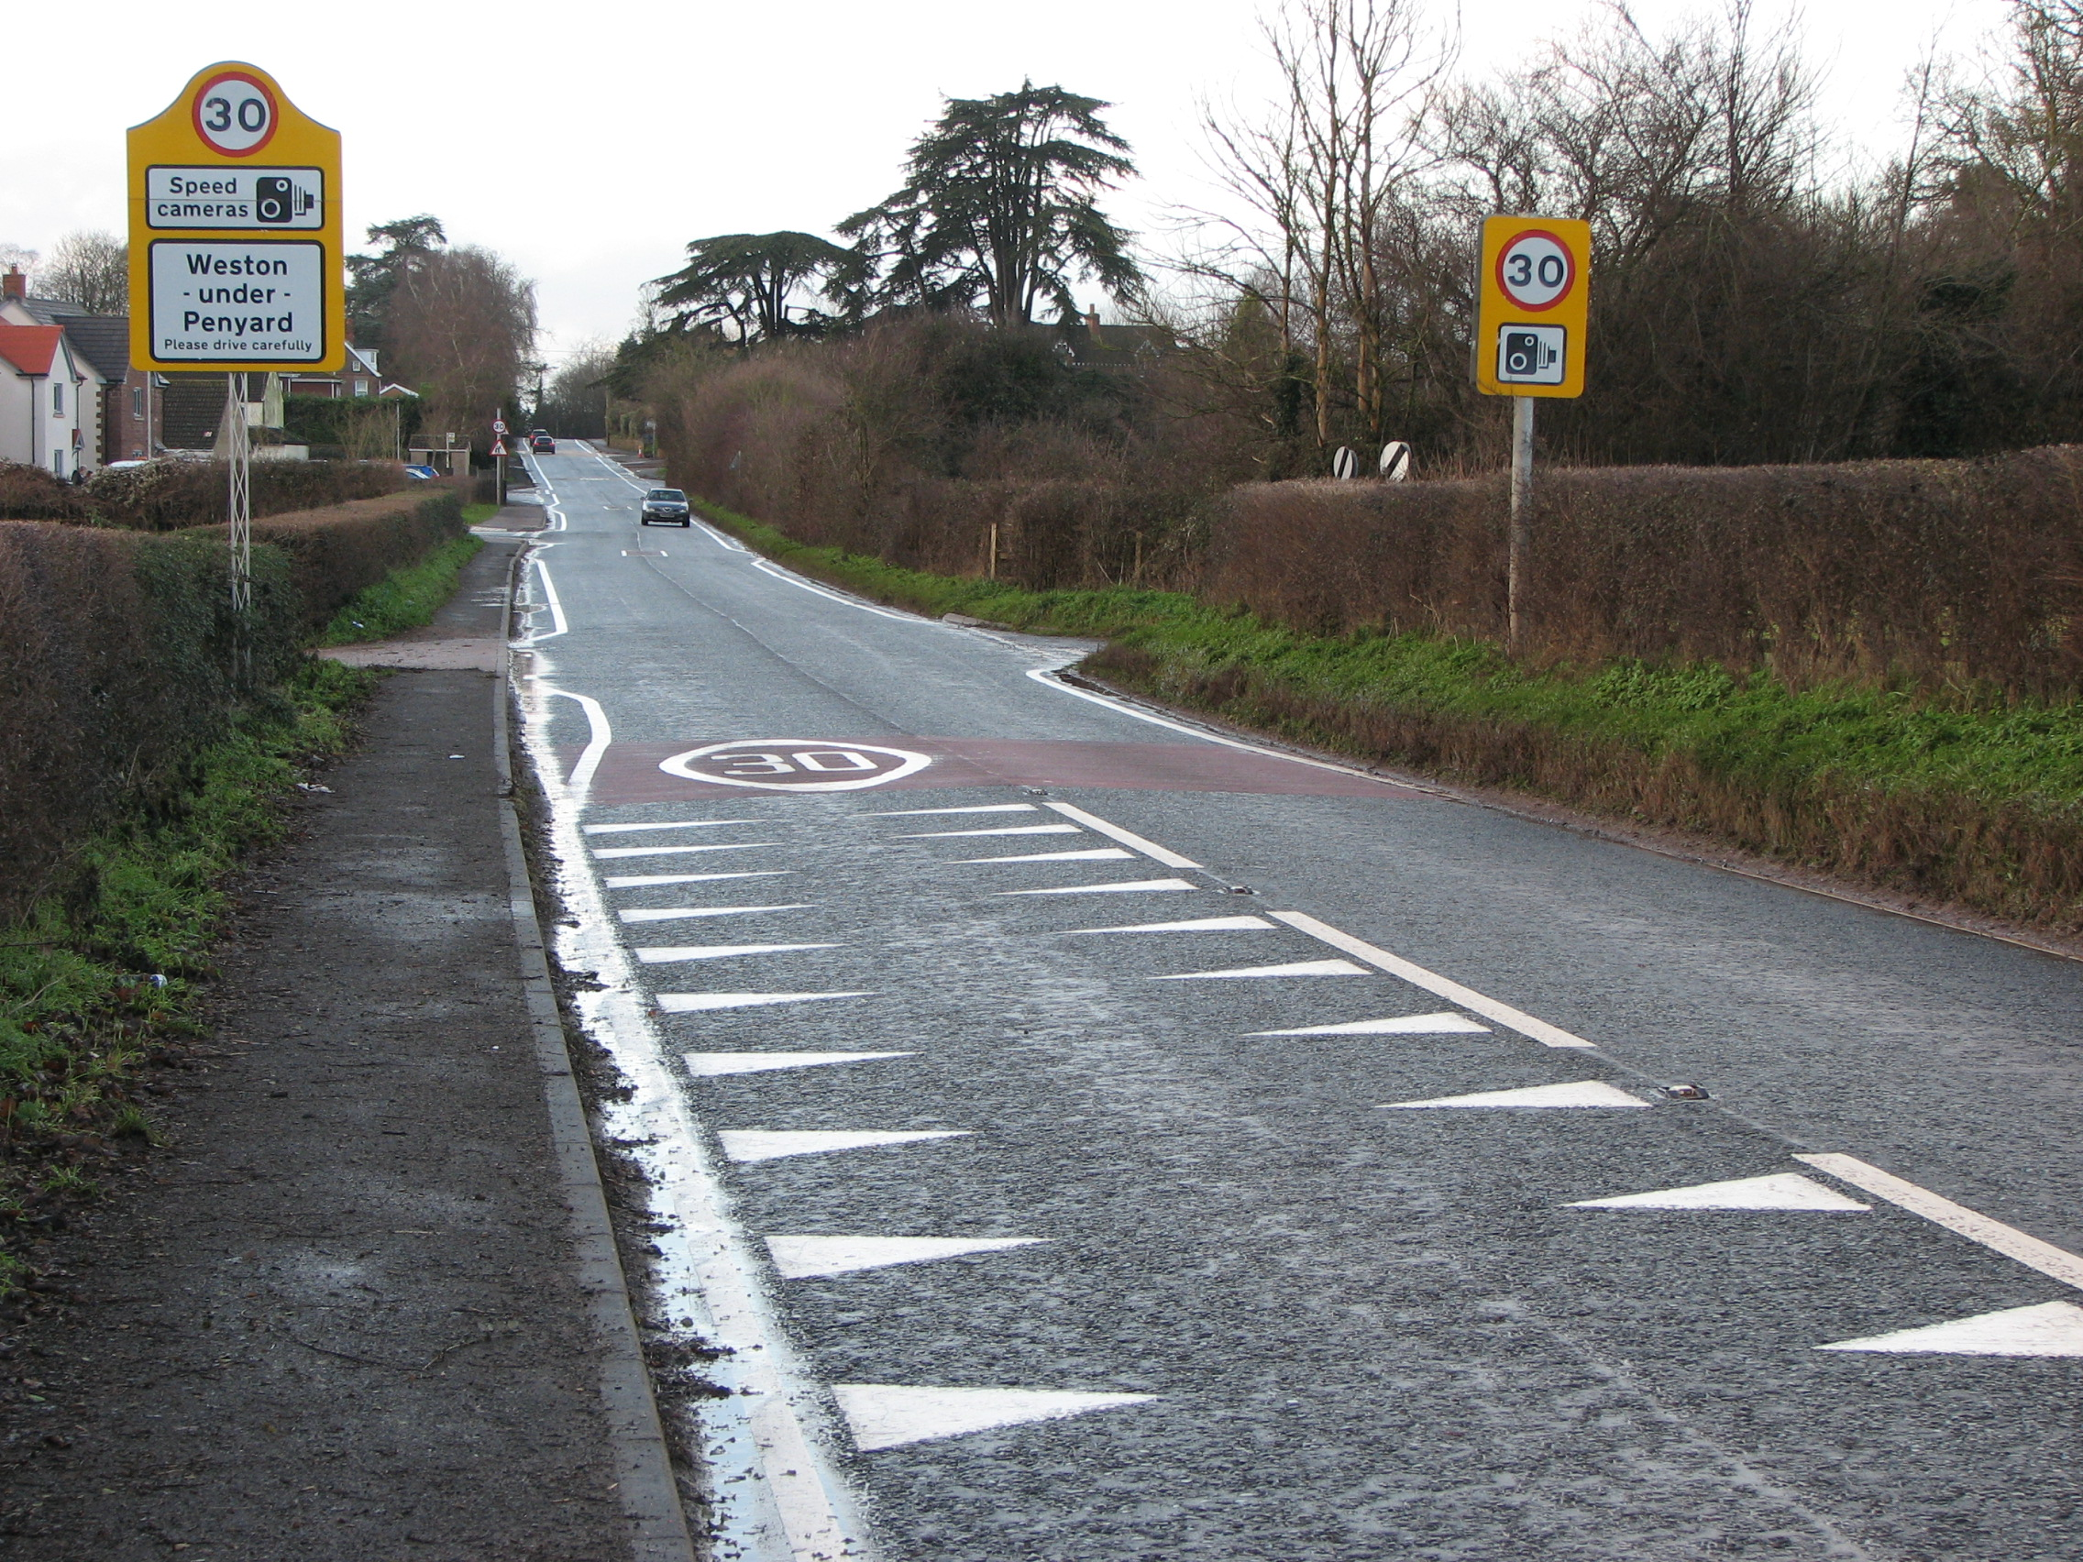
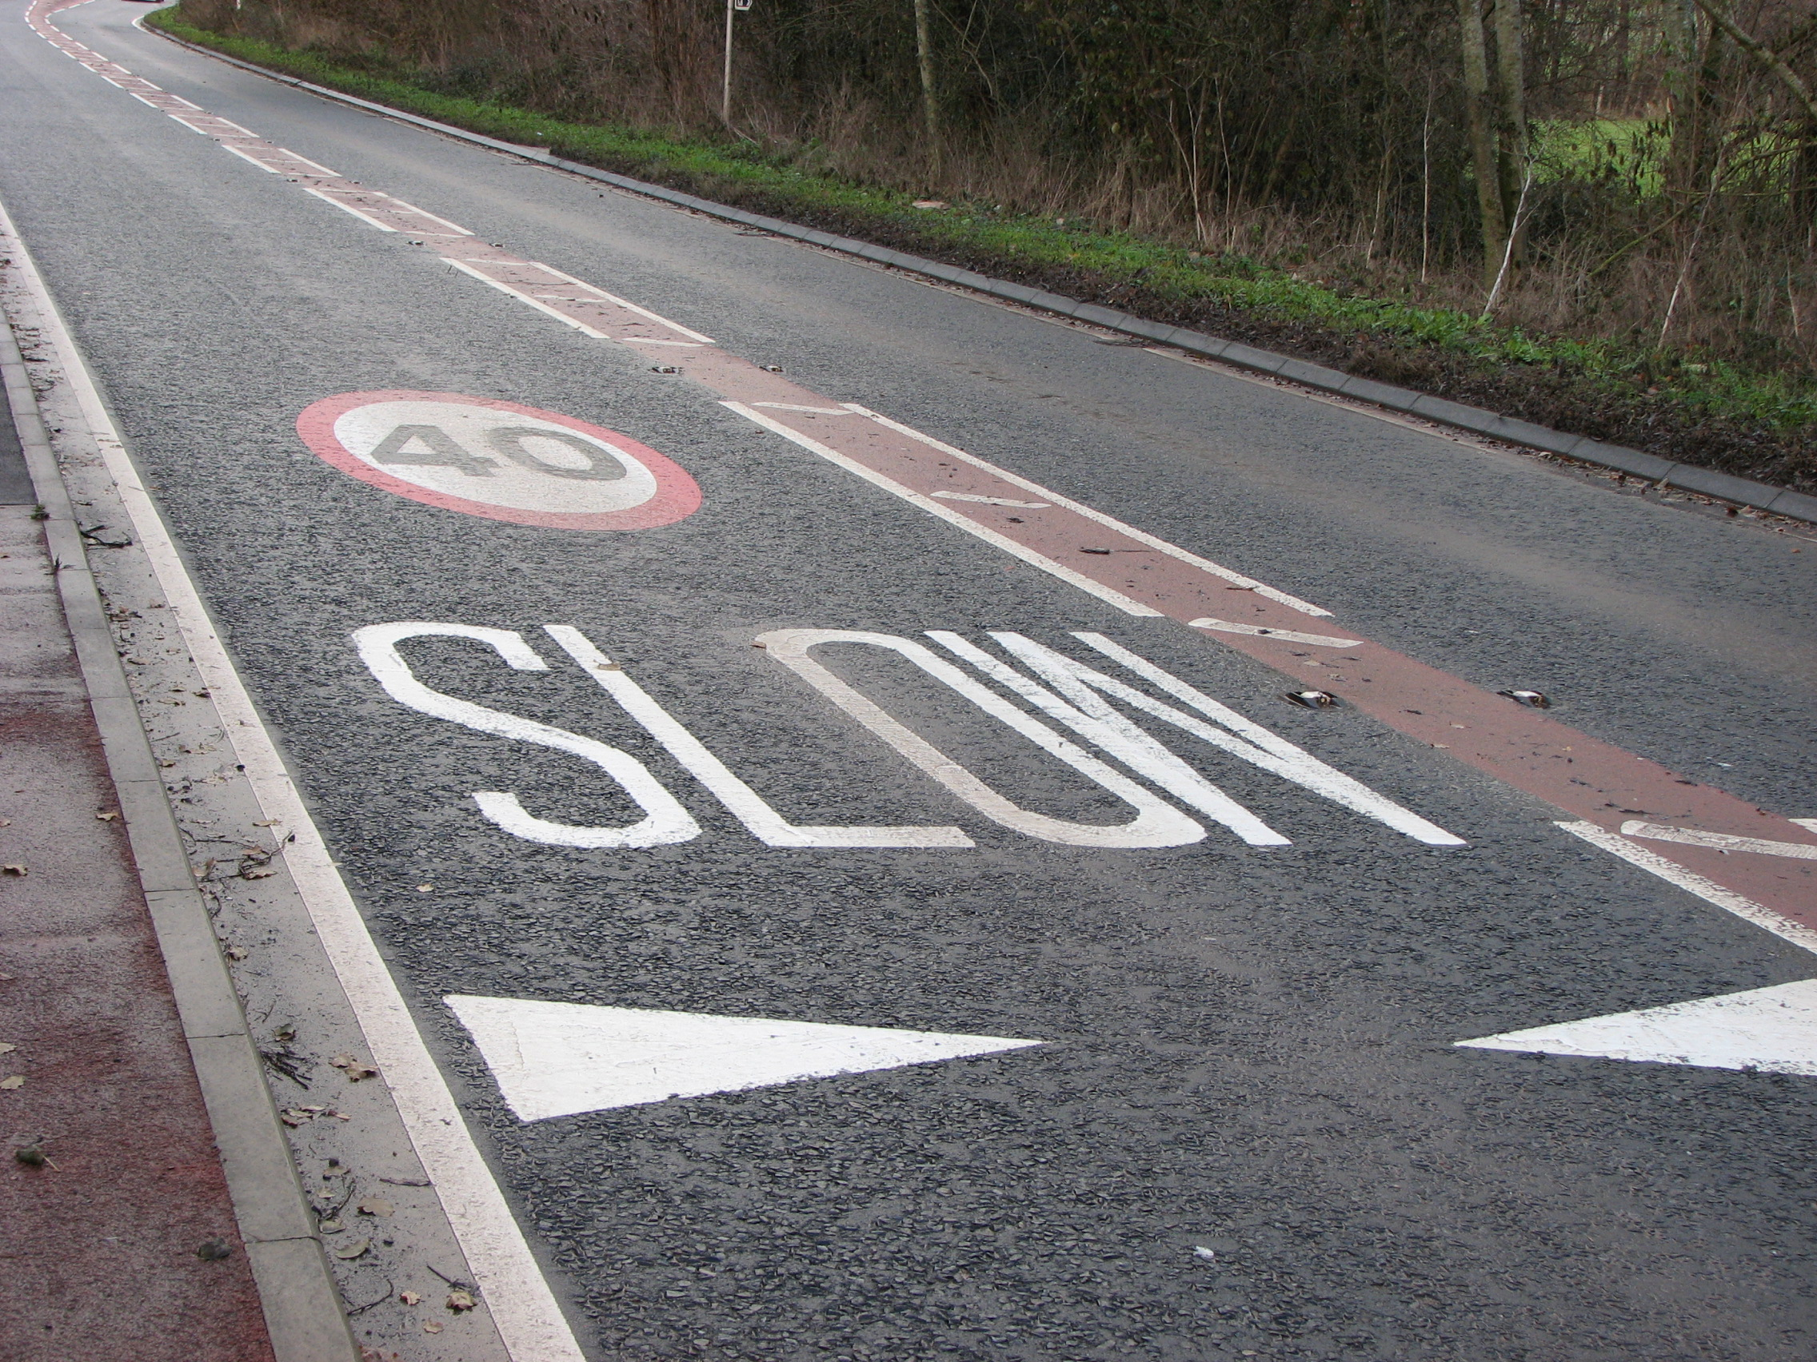
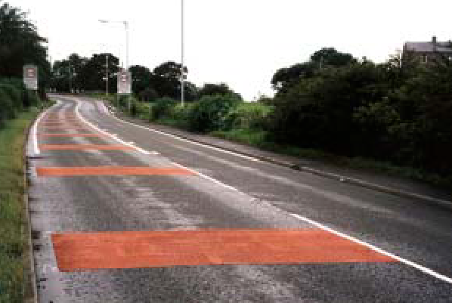
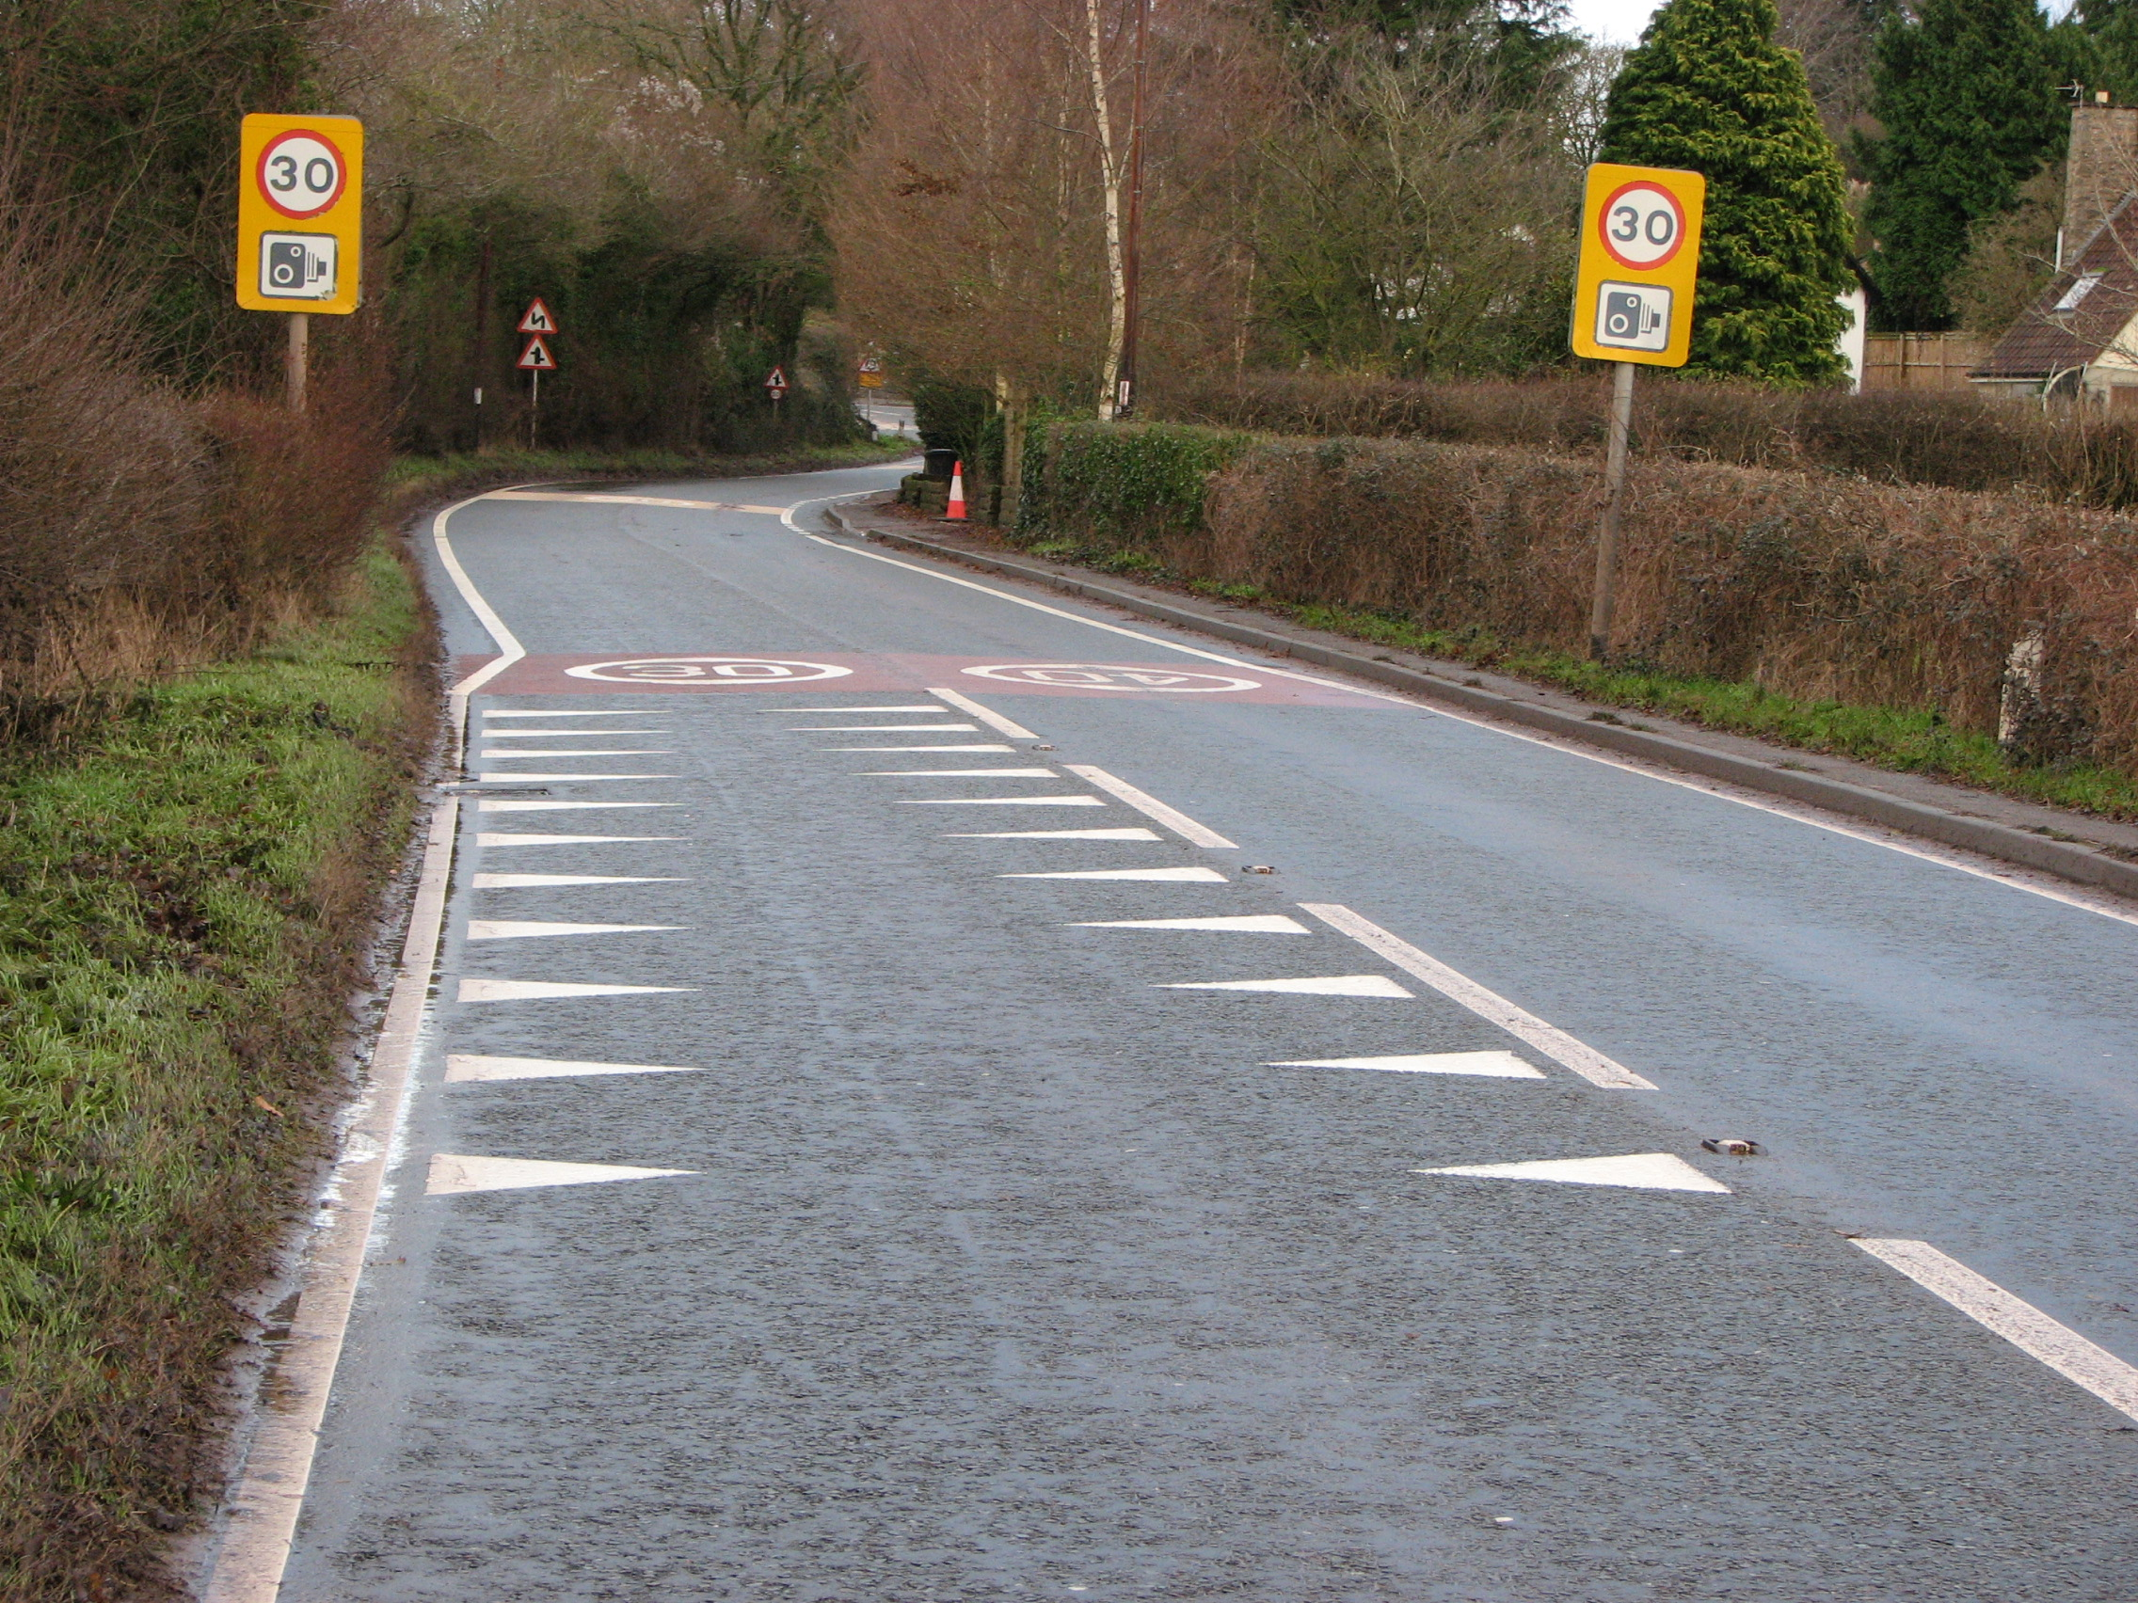
Priority 1 - Reduce Speed to Increase Safety
Improve terminal signage & gateway road markings
Review condition of existing sign. 30mph repeater signs
SLOW on buff/red surface dressing prior & at 30/40mph gateways
Dragons teeth & 30mph markings on approach

Slide 10
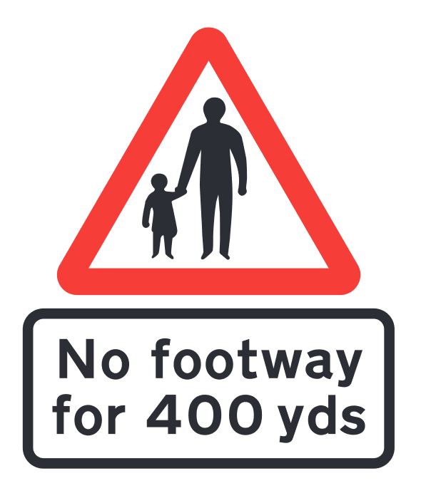
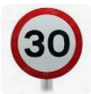
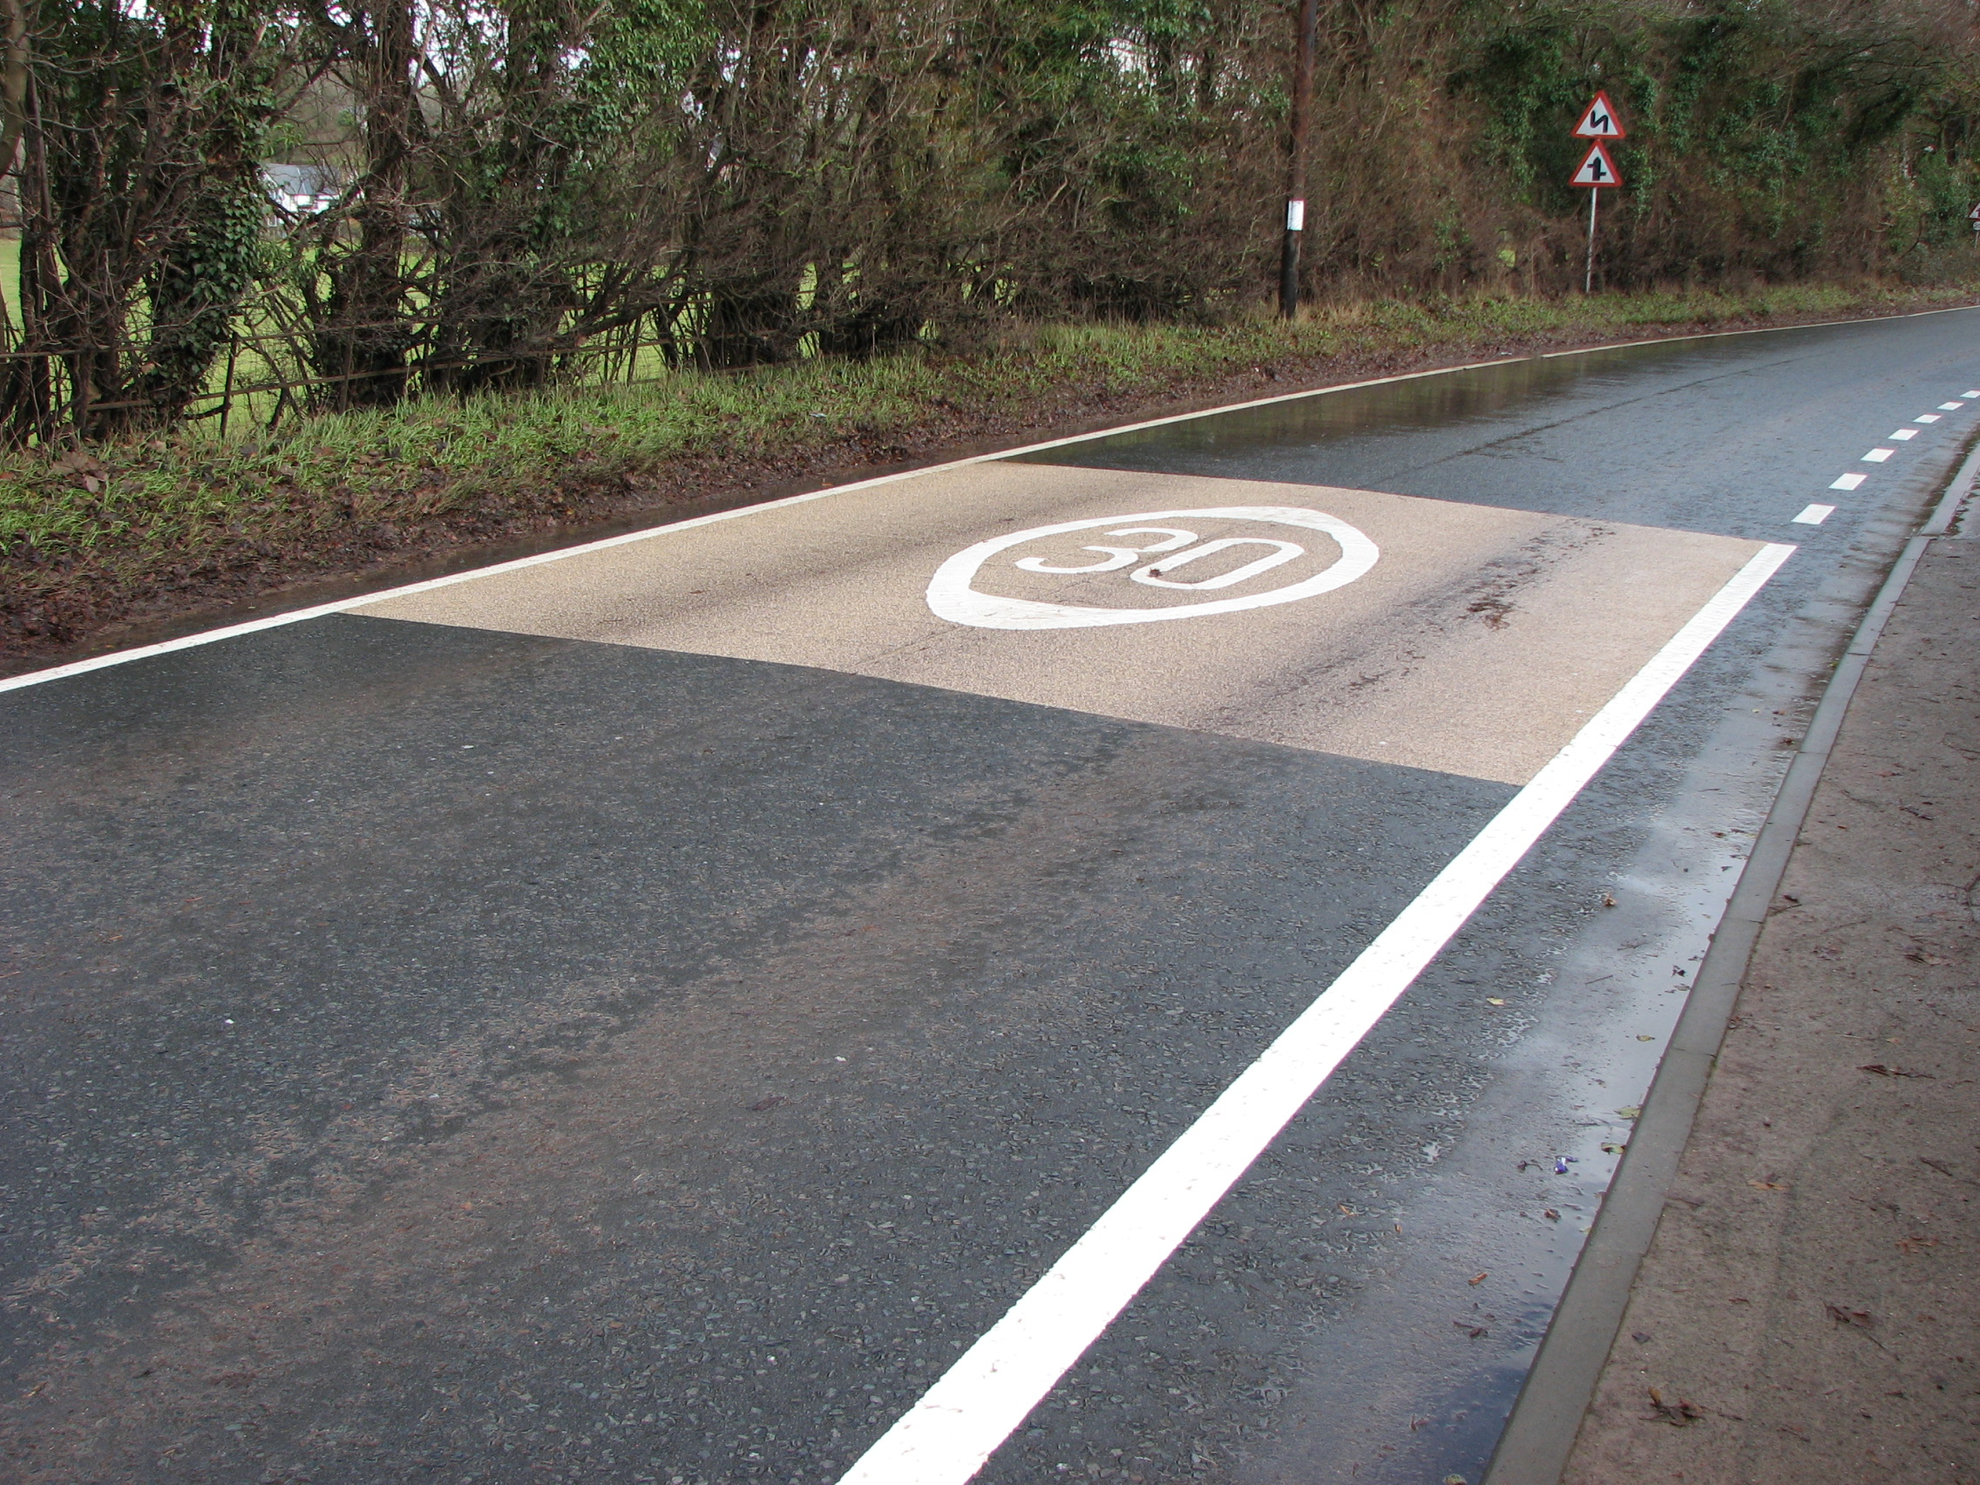
Priority 1 - Reduce Speed to Increase Safety
2. Improve warning signs & road markings
Road marking - 30/40mph roundels on buff/red surface dressing
Sharp deviation / bollards on bends at Phocle Green/Old Gore
SLOW road markings on approach to crossroads & bends at Phocle Green
Road narrows at The Crews
Pedestrians - No footway

Slide 11
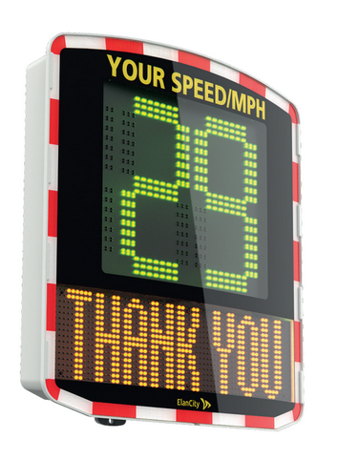
Priority 2 - Speed & Safety support measures
3. Install radar speed signs - solar powered
Feasibility and suitable locations - consult BBLP & HCC Highways Engineers
Installation costs unknown
Ongoing costs - discussed with Chairman - budget - insurance
Approx. £5,000 per unit
2yr guarantee on parts & labour
6mths on battery
warranty does not cover vandalism, impact damage, theft

Slide 12
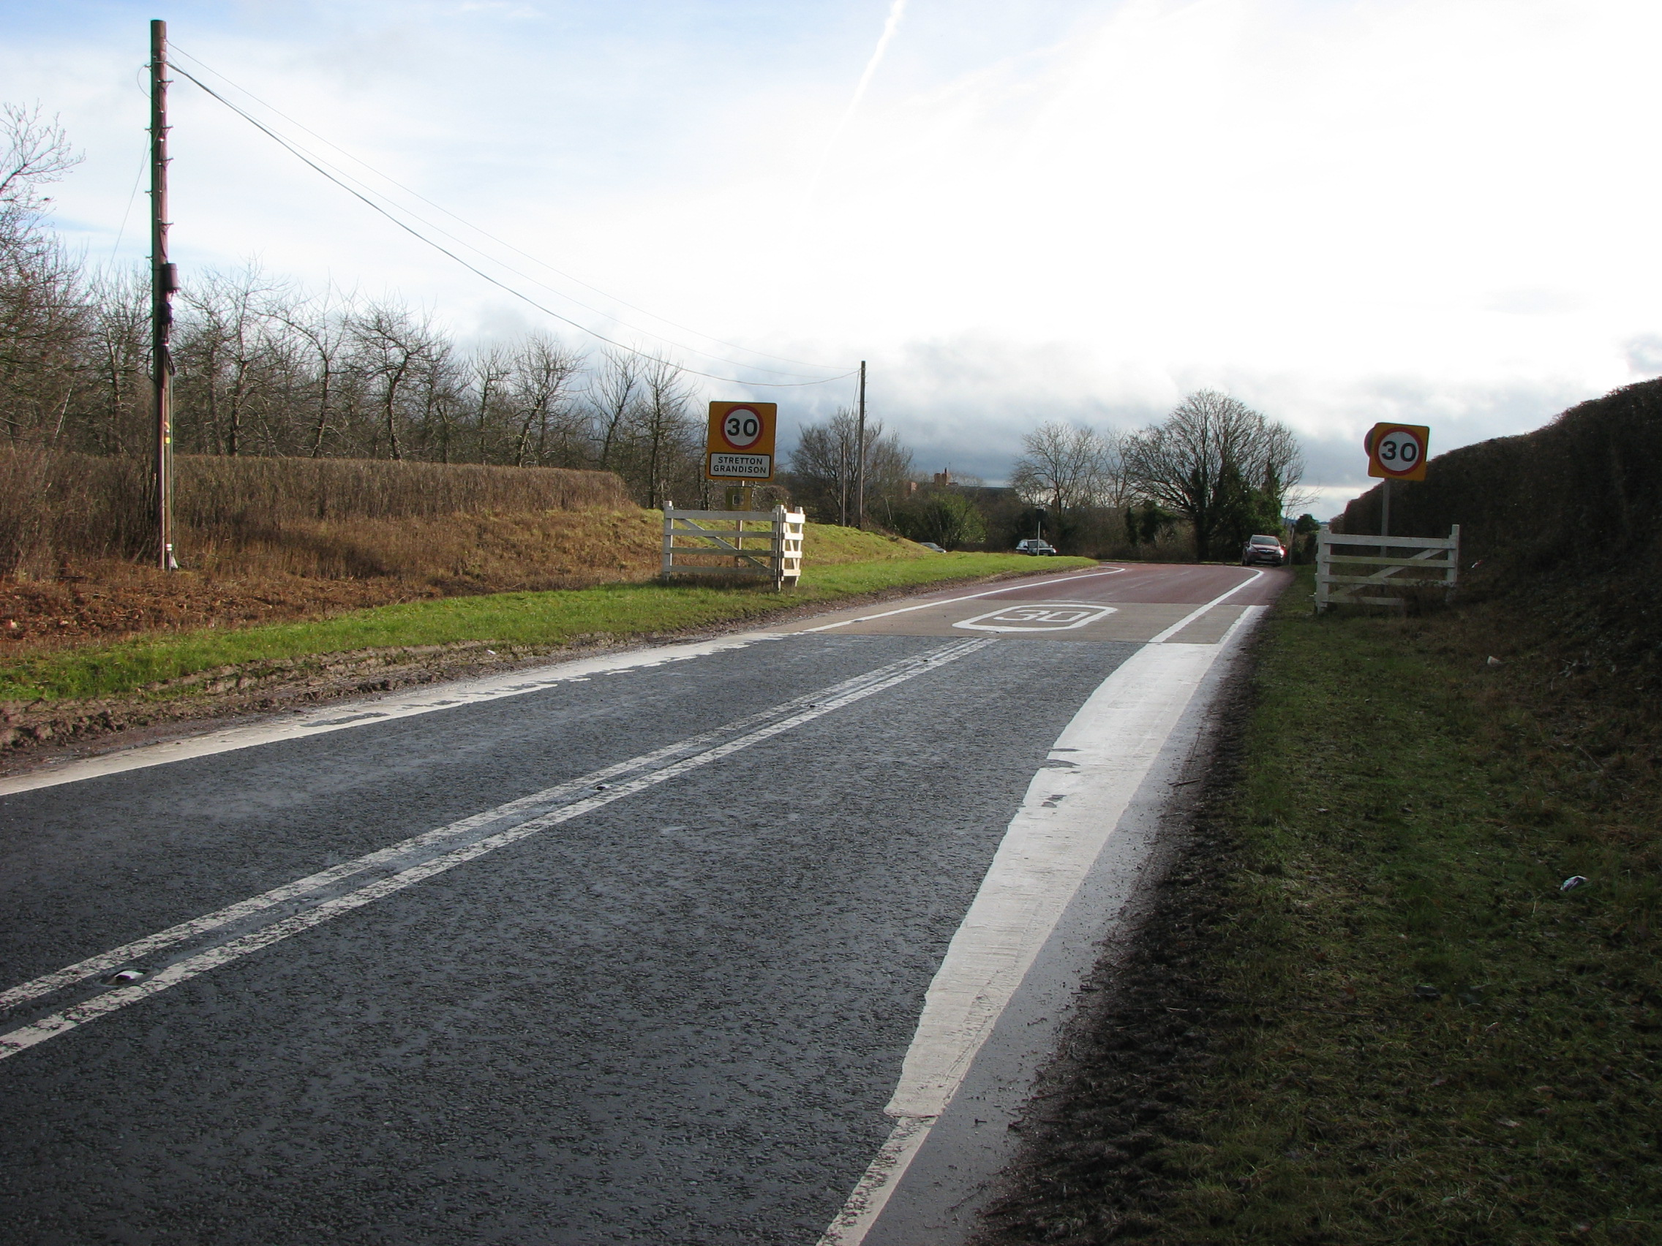
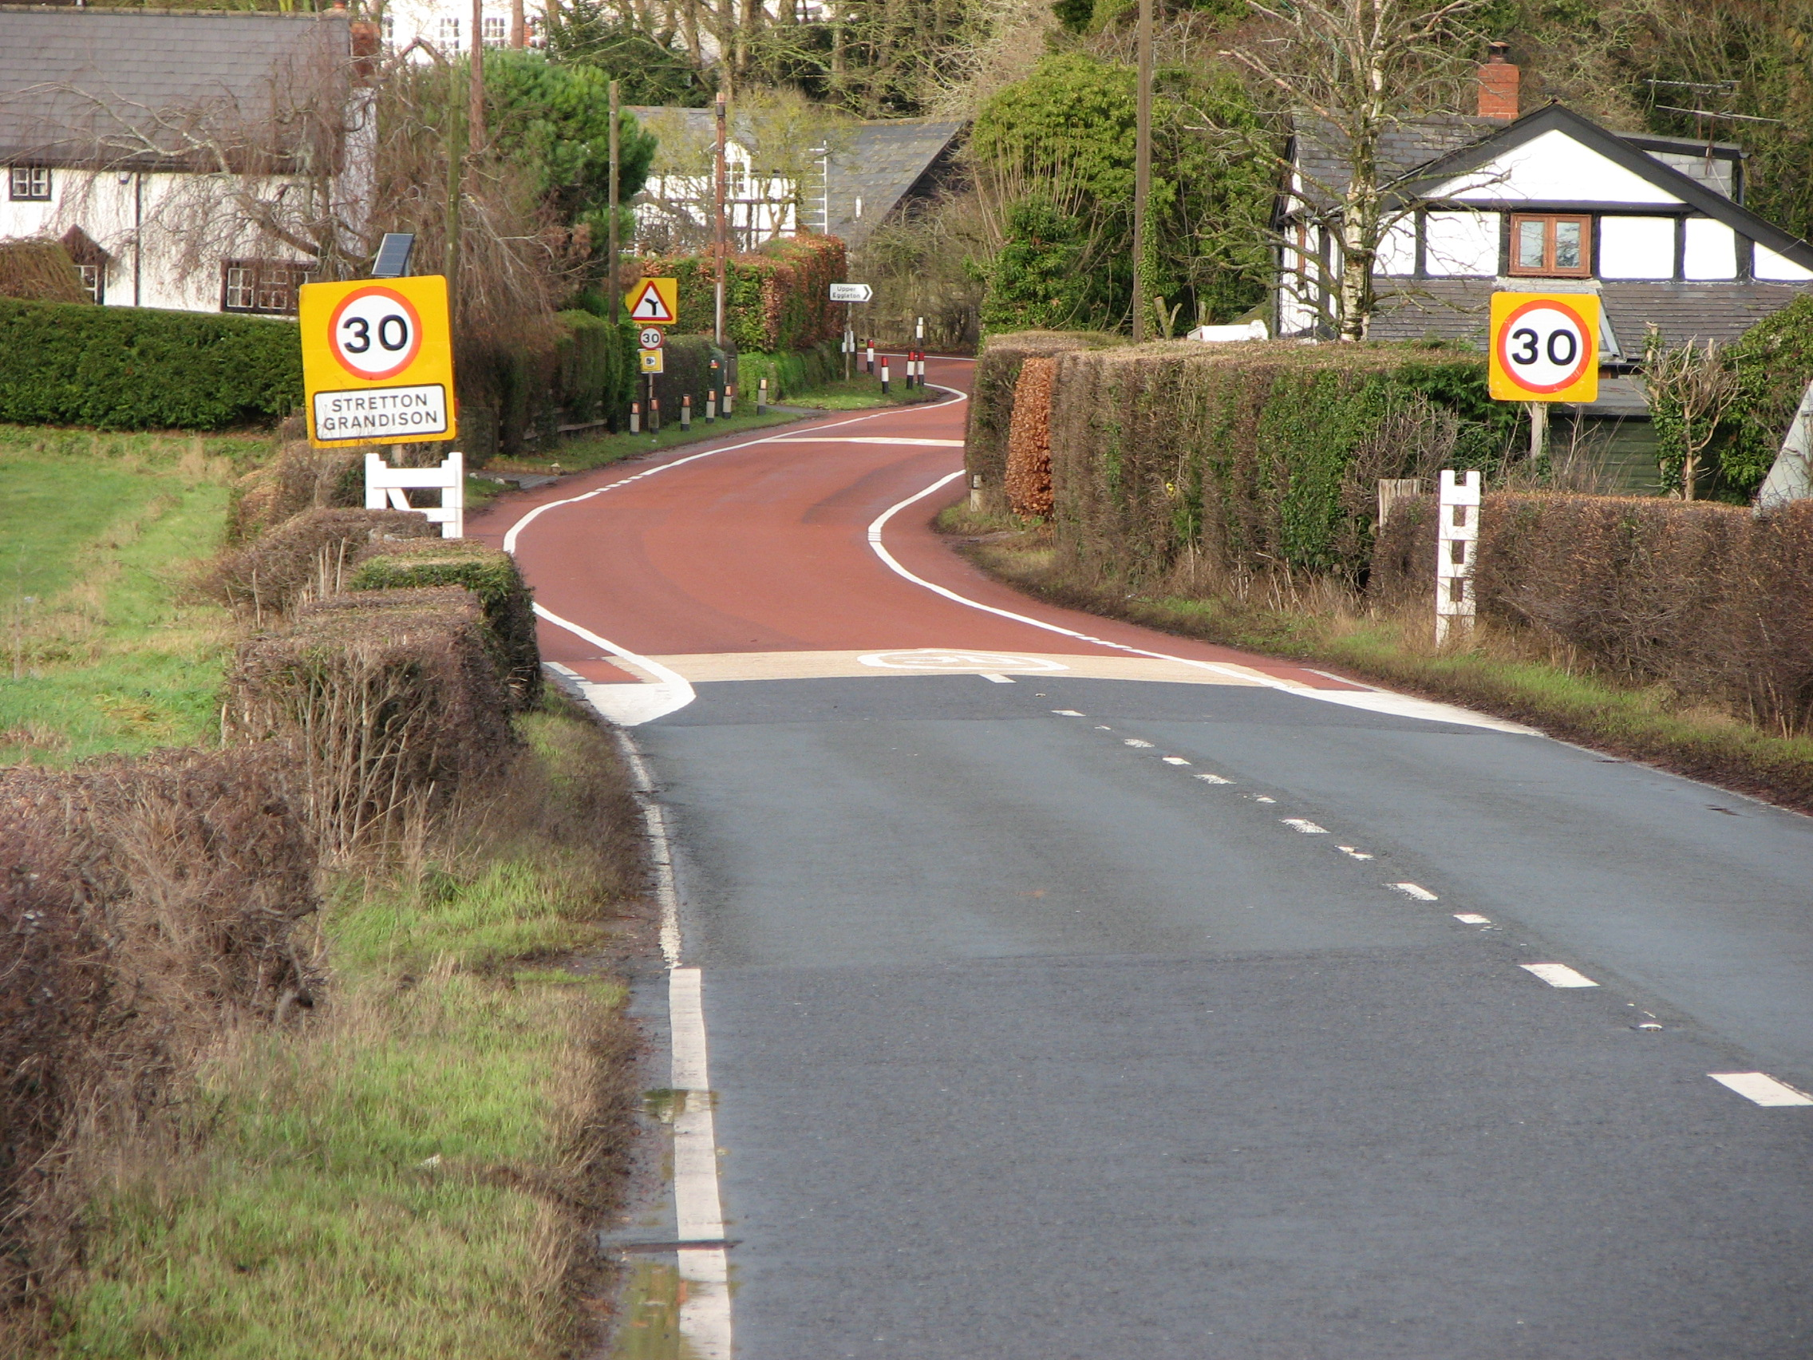
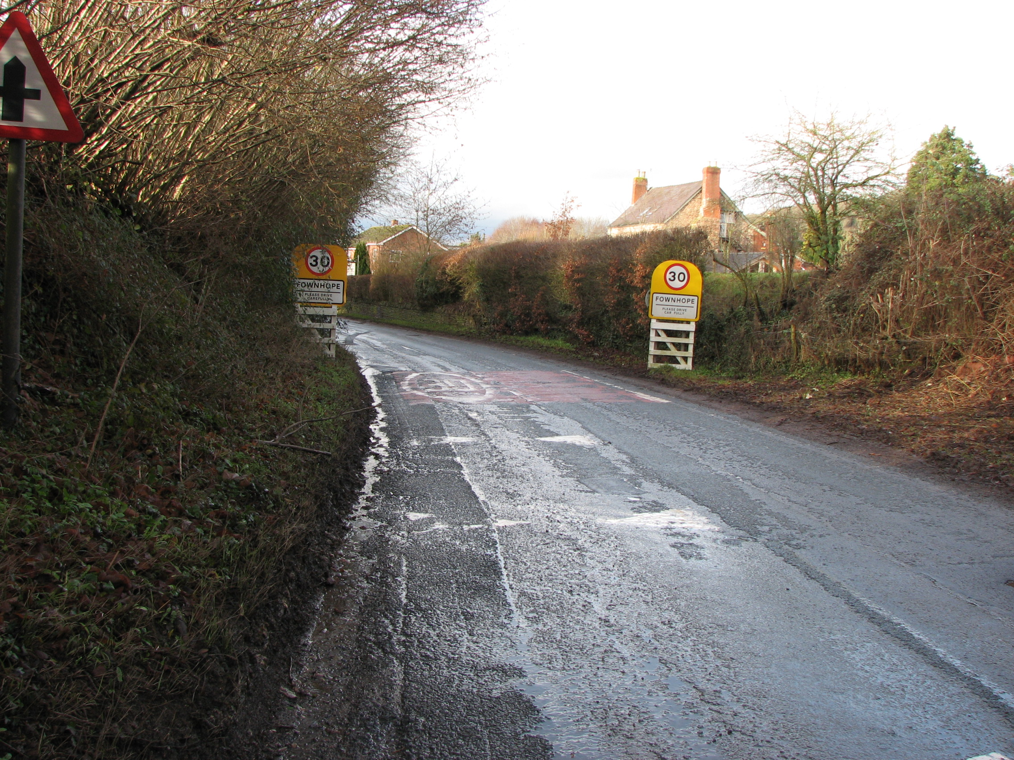
Priority 2 - Speed & Safety support measures
4. Install white gates at village gateways
Provides visual indication that drivers are entering a village area
Approx. £5000 to purchase 4 pairs of 1m wide gates

Slide 13
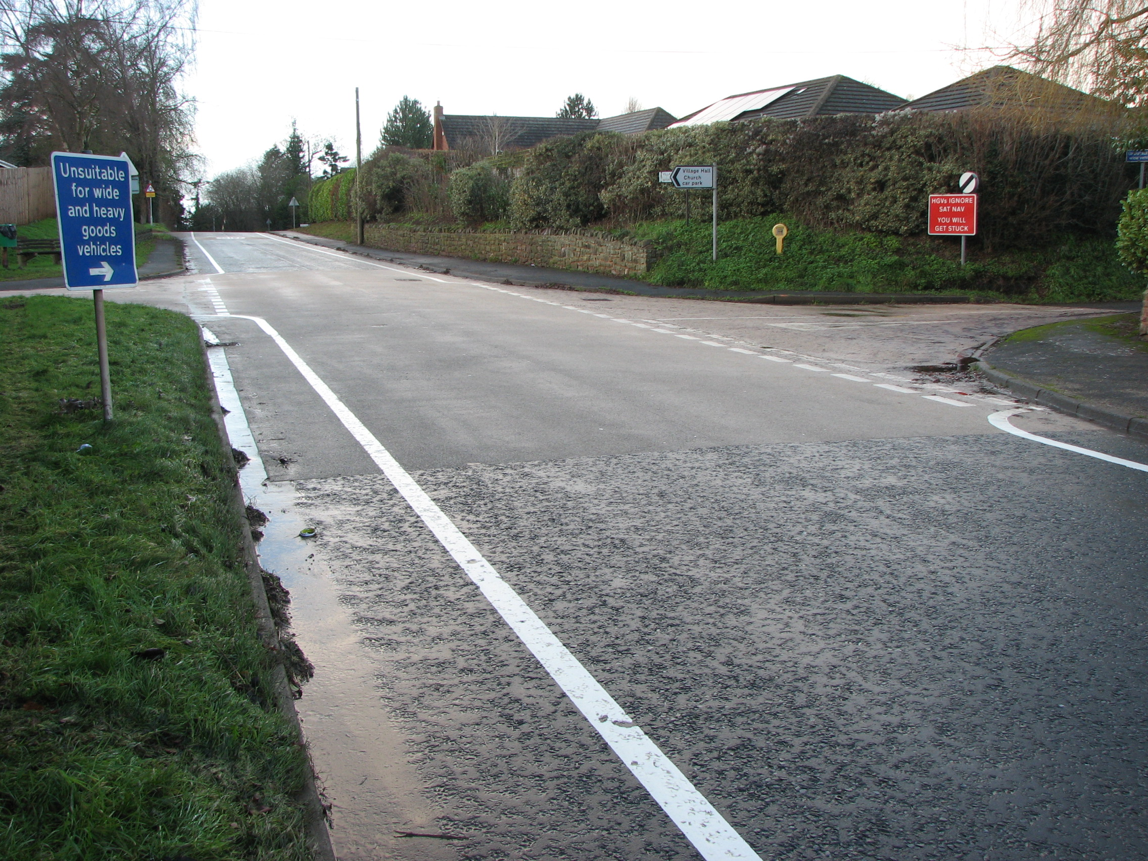
Priority 3 - Traffic calming
5. Add white kerb line & remove centre white line marking.
Visually reduces road width creating more cautious approach
Review road & junction suitability

Slide 14
Priority 3 - Traffic calming
5. Add white kerb line & remove centre white line marking.
6. Install ‘rumble strips’ at village boundaries.

Slide 15
Priority 3 - Traffic calming
5. Add white kerb line & remove centre white line marking.
6. Install ‘rumble strips’ at village boundaries.
7. Restrict junction widths -
turn onto B4224 Bromsash Road
By road markings or alter kerb line

Slide 16
Priority 3 - Traffic calming
5. Add white kerb line & remove centre white line marking.
6. Install ‘rumble strips’ at village boundaries.
7. Restrict junction widths
8. Restrict road width with priority traffic flow - Priority narrowing

Slide 17
Priority 4 - Vehicle & Traffic Restrictions
9. Extend 30mph on B4224 towards Old Gore

Slide 18
Priority 4 - Vehicle & Traffic Restrictions
9. Extend 30mph on B4224 towards Old Gore
10. Reduce 60mph National Speed Limit at Phocle Green

Slide 19
Priority 4 - Vehicle & Traffic Restrictions
9. Extend 30mph on B4224 towards Old Gore
10. Reduce 60mph National Speed Limit at Phocle Green
11. Extend 30mph on UC1286 past The Crews crossroads junction

Slide 20
Priority 4 - Vehicle & Traffic Restrictions
9. Extend 30mph on B4224 towards Old Gore
10. Reduce 60mph National Speed Limit at Phocle Green
11. Extend 30mph on UC1286 past The Crews crossroads junction
12. A449 speed reduction - Old Gore crossroads project

Slide 21
Priority 4 - Vehicle & Traffic Restrictions
9. Extend 30mph on B4224 towards Old Gore
10. Reduce 60mph National Speed Limit at Phocle Green
11. Extend 30mph on UC1286 past The Crews crossroads junction
12. A449 speed reduction - Old Gore crossroads project
13. 20mph zone around Crow Hill centre

Slide 22
Priority 4 - Vehicle & Traffic Restrictions
9. Extend 30mph on B4224 towards Old Gore
10. Reduce 60mph National Speed Limit at Phocle Green
11. Extend 30mph on UC1286 past The Crews crossroads junction
12. A449 40mph compliance issue - Old Gore crossroads project
13. 20mph zone around Crow Hill centre
14. Install speed bumps

Slide 23
Priority 4 - Vehicle & Traffic Restrictions
9. Extend 30mph on B4224 towards Old Gore
10. Reduce 60mph National Speed Limit at Phocle Green
11. Extend 30mph on UC1286 past The Crews crossroads junction
12. A449 speed reduction - Old Gore crossroads project
13. 20mph zone around Crow Hill centre
14. Install speed bumps
15. Removal of ‘Give Way’ signs & markings at B4224 & B4221 junction by Moody Cow

Slide 24
Priority 4 - Vehicle & Traffic Restrictions
9. Extend 30mph on B4224 towards Old Gore
10. Reduce 60mph National Speed Limit at Phocle Green
11. Extend 30mph on UC1286 past The Crews crossroads junction
12. A449 speed reduction - Old Gore crossroads project
13. 20mph zone around Crow Hill centre
14. Install speed bumps
15. Removal of ‘Give Way’ signs & markings at B4224 & B4221 junction by Moody Cow
16. Weight limits to restrict HGV’s through village

Slide 25
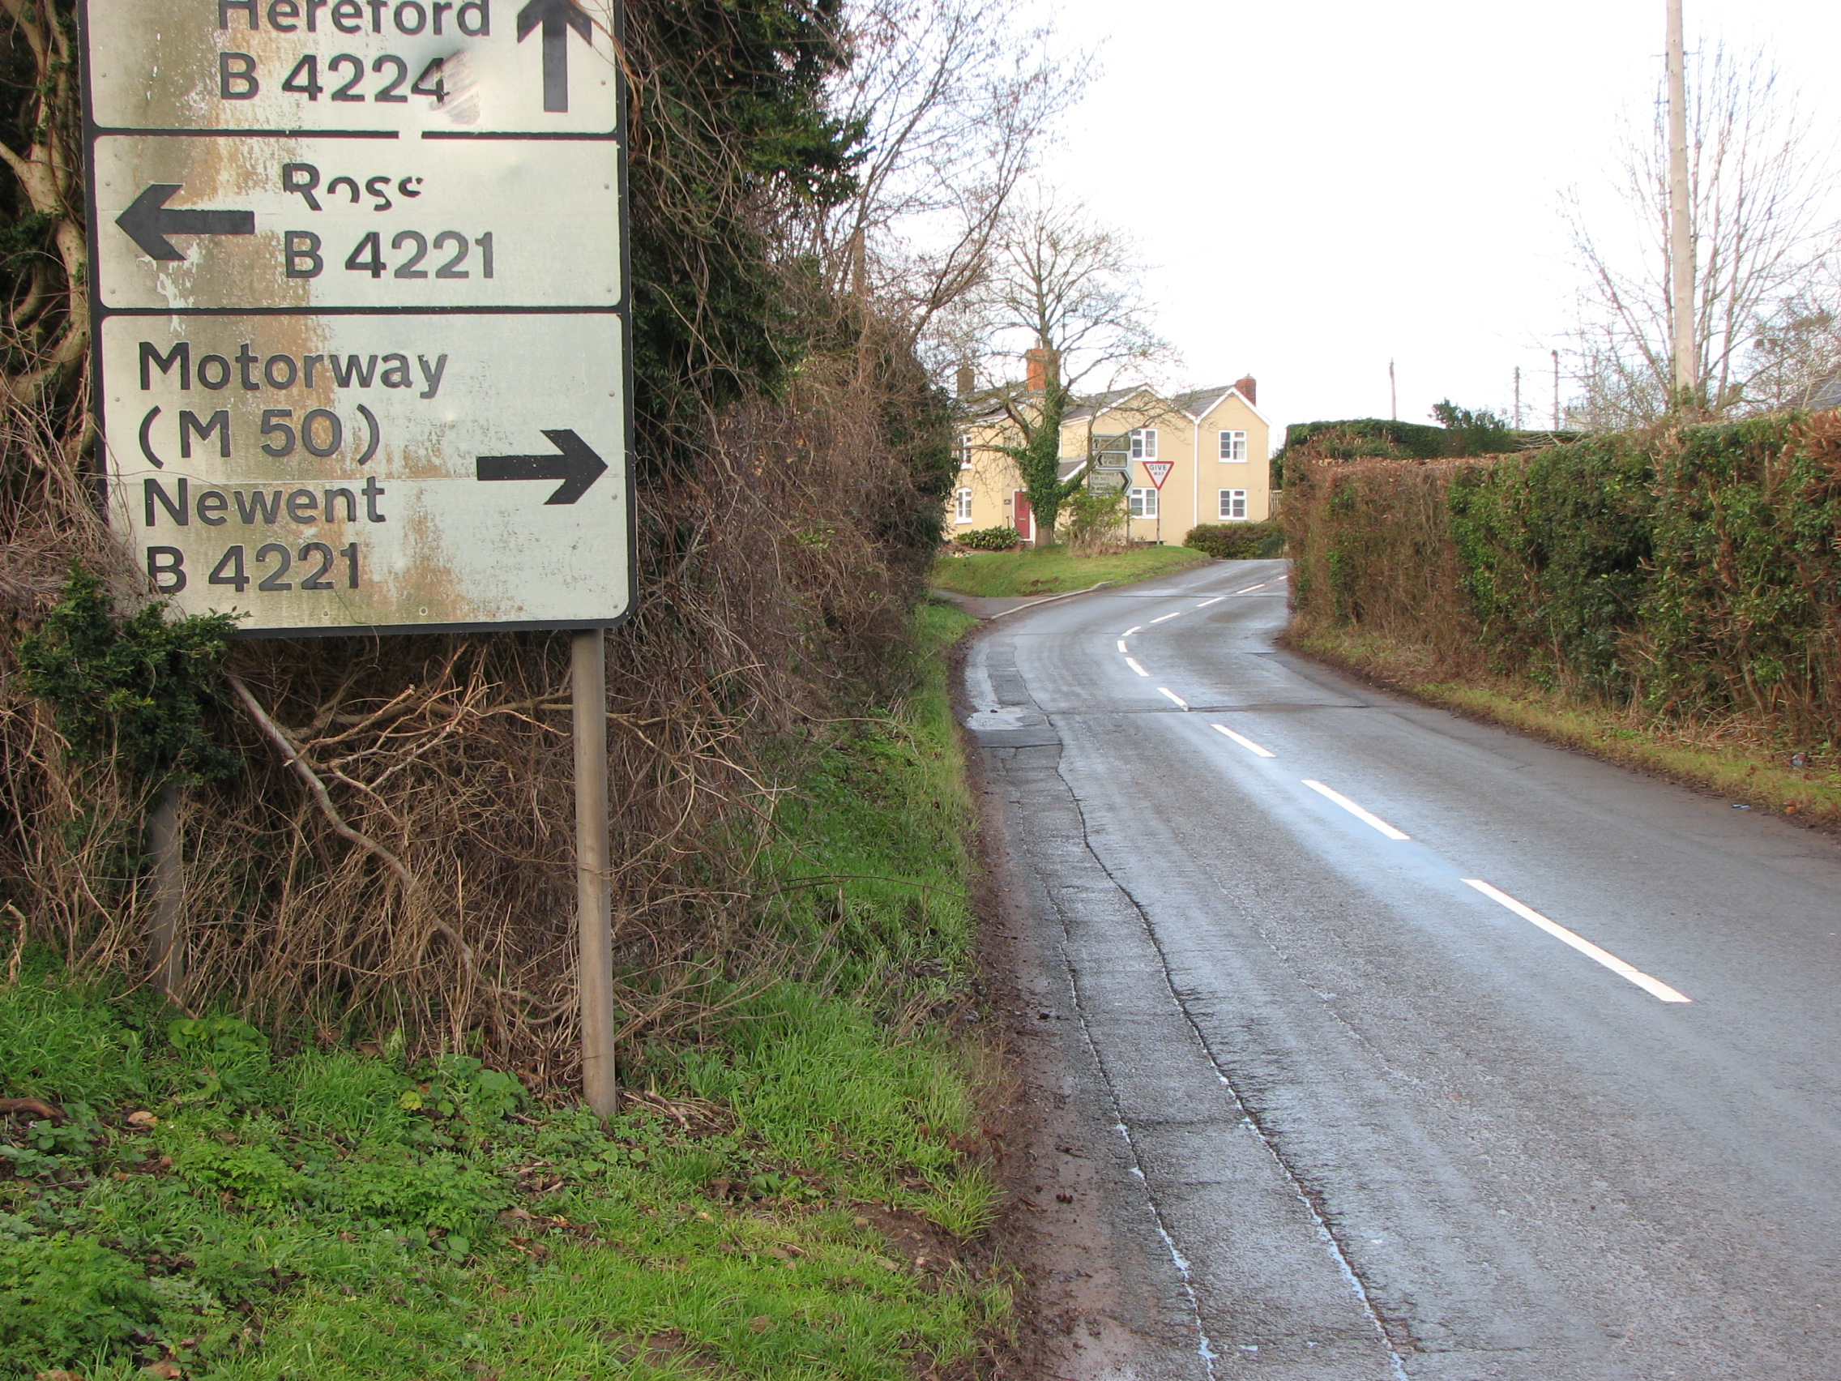
Priority 5 - Improvements to pedestrian access
17. Install footpath between Spring Meadow & Moody Cow
Improve safe pedestrian access to village centre
Land ownership & hedge removal

Slide 26
Priority list
Priority 1 - Reduce Speed to Increase Safety
1. Improve terminal signage & gateway road markings
2. Improve warning signs & road markings
Priority 2 - Speed & Safety support measures
3. Install radar speed sign
4. Install white gates at village gateways
Priority 3 - Traffic calming
5. Add white kerb line & remove centre white line markings
6. Install ‘rumble strips’ at village boundaries
7. Restrict junction widths
8. Restrict road width with priority traffic flow - Priority narrowing
Priority 4 - Vehicle & Traffic Restrictions
9. Extend 30mph on B4224 towards Old Gore
10. Reduce 60mph National Speed Limit at Phocle Green
11. Extend 30mph on UC1286 past The Crews crossroads junction
12. A449 speed reduction - Old Gore crossroads project
13. 20mph zone around Crow Hill centre
14. Install speed bumps
15. Removal of ‘Give Way’ signs & markings at B4224/B4221 junc by Moody Cow
16. Weight limits to restrict HGV’s through village
Priority 5 - Improvements to pedestrian access
17. Install footpath between Spring Meadow & Moody Cow

Slide 27
What’s next ?
Site meetings with HCC Highways Engineer & West Mercia Police Traffic Management Advisor to review proposals
What will they do ?
Check the scheme will work correctly on the road
Ensure the scheme is safe
Assess for any unintended consequences
Check the scheme is compliant with Highway regulations
Prepare costing
REMEMBER; Some roads will not be suitable for certain ideas.
The Parish Council may need to further amend the Proposed List following site meetings to take into account feasibility and costing of each proposal.

Slide 28
Chairman

Slide 29
Questions

Slide 30
Priority list
Priority 1 - Reduce Speed to Increase Safety
1. Improve terminal signage & gateway road markings
2. Improve warning signs & road markings
Priority 2 - Speed & Safety support measures
3. Install radar speed sign
4. Install white gates at village gateways
Priority 3 - Traffic calming
5. Add white kerb line & remove centre white line markings
6. Install ‘rumble strips’ at village boundaries
7. Restrict junction widths
8. Restrict road width with priority traffic flow - Priority narrowing
Priority 4 - Vehicle & Traffic Restrictions
9. Extend 30mph on B4224 towards Old Gore
10. Reduce 60mph National Speed Limit at Phocle Green
11. Extend 30mph on UC1286 past The Crews crossroads junction
12. A449 speed reduction - Old Gore crossroads project
13. 20mph zone around Crow Hill centre
14. Install speed bumps
15. Removal of ‘Give Way’ signs & markings at B4224/B4221 junc by Moody Cow
16. Weight limits to restrict HGV’s through village
Priority 5 - Improvements to pedestrian access
17. Install footpath between Spring Meadow & Moody Cow

Slide 31
Upton Bishop
Traffic Calming & Speed Reduction Proposals

